Slide 1


Zagazig University
Faculty of Computers and Informatics
Information Technology Department
Computer Science Department
2016
Team Member:
Amr Reda Ramadan
Sohaila Nasser
Eslam Saber
Amal Fatouh
Ahamed Abdelhaman
Mohamed Abdelwaheed

Slide 2

Smart Lighting Poles Using IOT

Slide 3
Agent Outlines
01
Abstract
02
Solution
03
Implementation
04
Results

Slide 4
Project idea
We made an integrated system that can
monitor the network of electricity
distribution poles that detects problems
and takes a suitable action .
The proposed system is based on small
modules embedded with new technology
of Internet of Thing (IOT).
.

Slide 5
Problems that we solve
Many problems can be appeared in any electricity system Such as :
1
There are much amount of electricity used by Searchlights in electrical poles and controlling the amount of electricity used by pole lightening system
2
Electrical fires and electrical devices damage
3
Excessive energy use
4
Difficulties in detecting faults (damaged LEDs)

Slide 6
Project Description
The server helps in
the management of the electricity network
in many areas.
The system benefits from the IOT technology in connecting the lighting poles with a central server .
Modules contain micro-controller
In addition to a collection of intelligent sensors
and solar cells.
We seek to make rationalization of electricity consumption by using solar panels and solve most of the problems that can be caused by electricity such as fire outbreak, damage of electrical devices

Slide 7
Solution
First, for lighting: poles lighting is controlled by the people, so to overcome this problem the project provide a solution by
Connecting the lighting control centrally through the server located on a distribution network electricity, which can be programmed automatically to control lighting times.
These units can be used to reduce the intensity of light and
Use solar energy for street lighting to save energy.
The proposed units can detect damaged lamps
and inform the company of their location.
.

Slide 8
solution
Second, for breakdowns
Many faults occur without consumers feeling like Low voltage or high, which over time lead to damage to electrical equipment and sometimes fires erupt.
And by continuous measurement of the voltage of each light pole the transmission of this information to the electrical control network can identify fault
locations repair them before problems occur.
.

Slide 9
Solution
Thirdly, for the distribution of loads:
The electricity network provides three power supply lines that are distributed electricity consumption of homes through which must be the electrical loads are almost equal.
It is through measurement Voltage and current consumption per line and the transmission of this information to the electricity grid can be made
decisions Suitable for redistributing loads correctly.
.

Slide 10
Infographic Style
Hardware Implementation

Slide 11
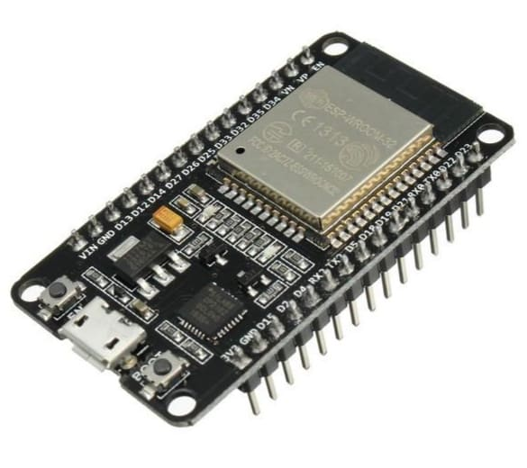
Esp32 Capability
WIFI & Bluetooth
.
Station & Access Point
CPU Frequency 160 MHZ &
power 3.3 V
2 UART
–40°C to +125°C.
36 PIN

Slide 12
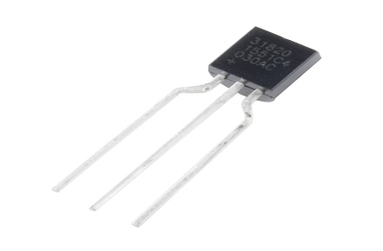
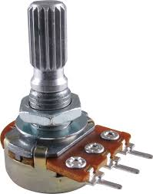
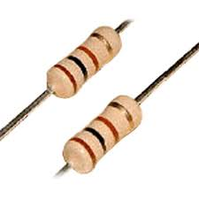
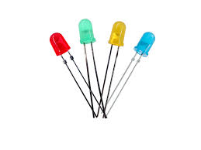
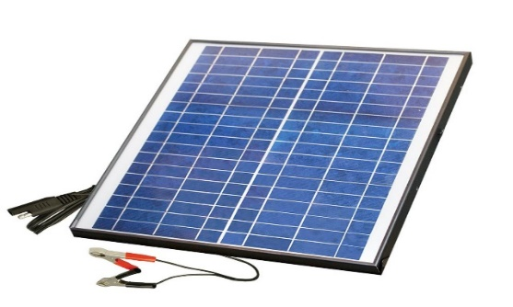
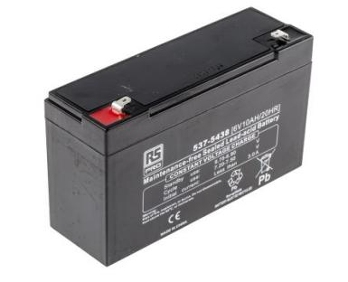
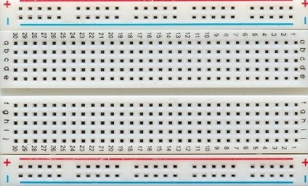
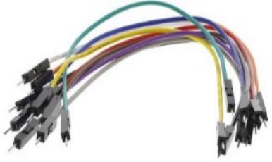
Sensors and Actuators
Resisters
Led
Potentiometer
temperature sensor
Bread Board
Wires
Solar panel
battery

Slide 13
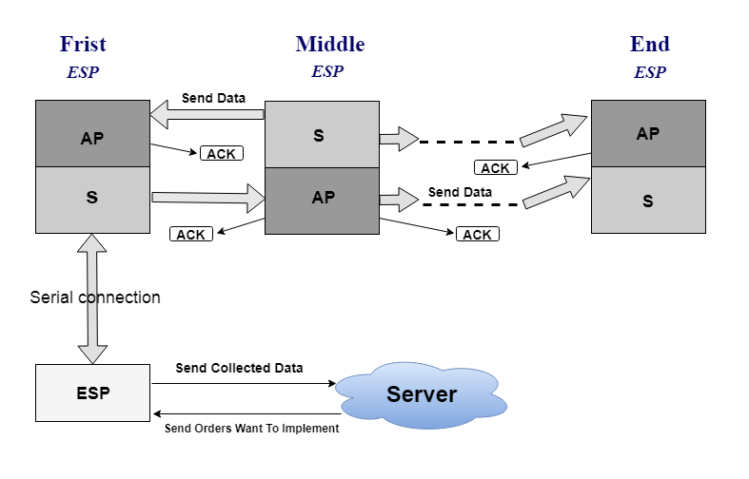
Connection between Modules
Each module can work into two modes (access point/station).
On system startup all of modules at the mode of access point.
Each module have a collection of sensors that collect information about the pole.
server sends commands to control the poles light and sent data collected back to the server.

Slide 14
Infographic Style
Software Implementation

Slide 15
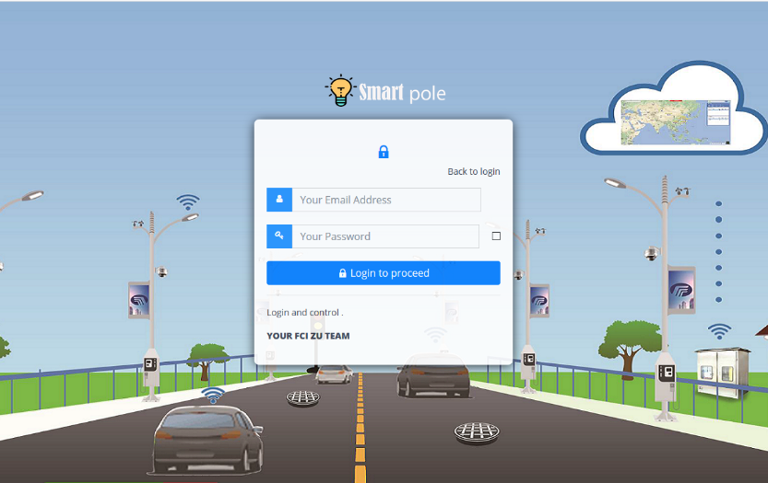
Software programming & scripting languages
The Web Site is built and programmed by:
Php
SQL
Java Script
AJAX
JSON
HTML5
CSS3
The Web Site contain of 6 main pages:
Login
Map
Control
Sensors
Notification Log
Update Password

Slide 16
Infographic Style
Results And Discussion

Slide 17
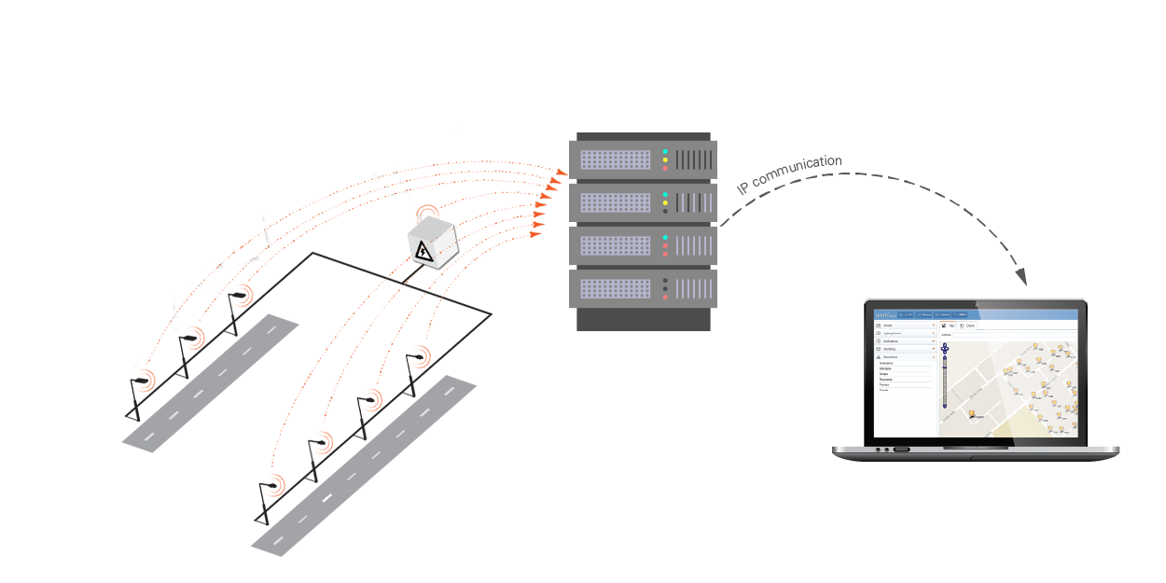
The technology of Internet of things in connecting the poles of lighting to a central computer (server) to monitor the network of Light poles.
Enable energy saving and identify and analyze faults.

Slide 18
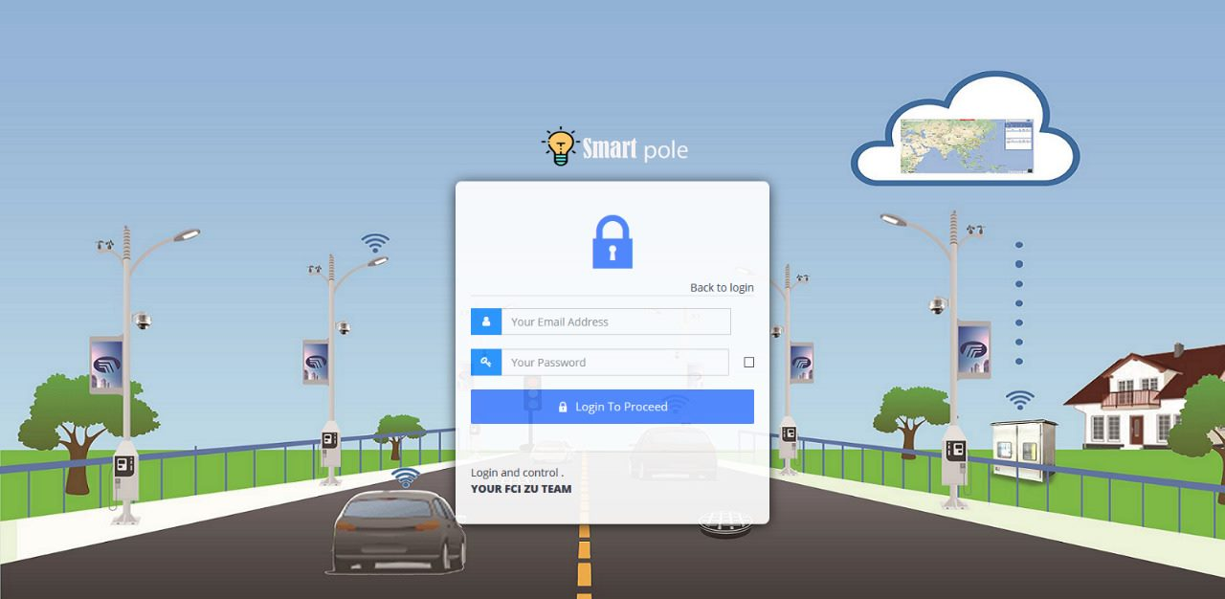
Login page
The admin enter email and password to access website.

Slide 19
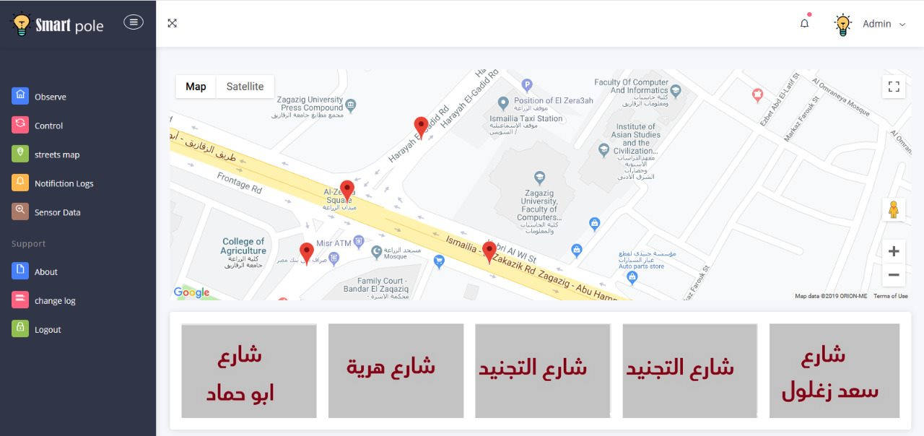
Map page
Admin select the area that he want to show its data.

Slide 20
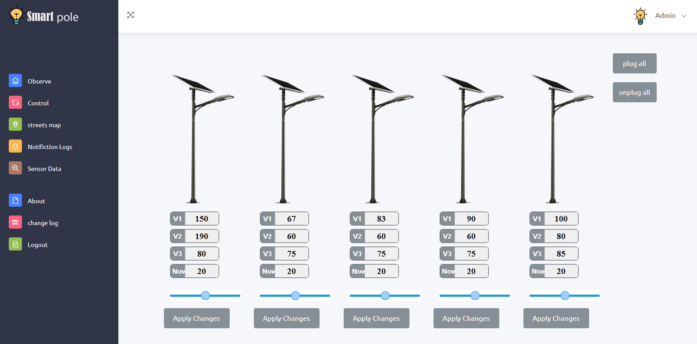
Main page
Admin can see the lines readings, plug or unplug all leds and control leds intensity.

Slide 21
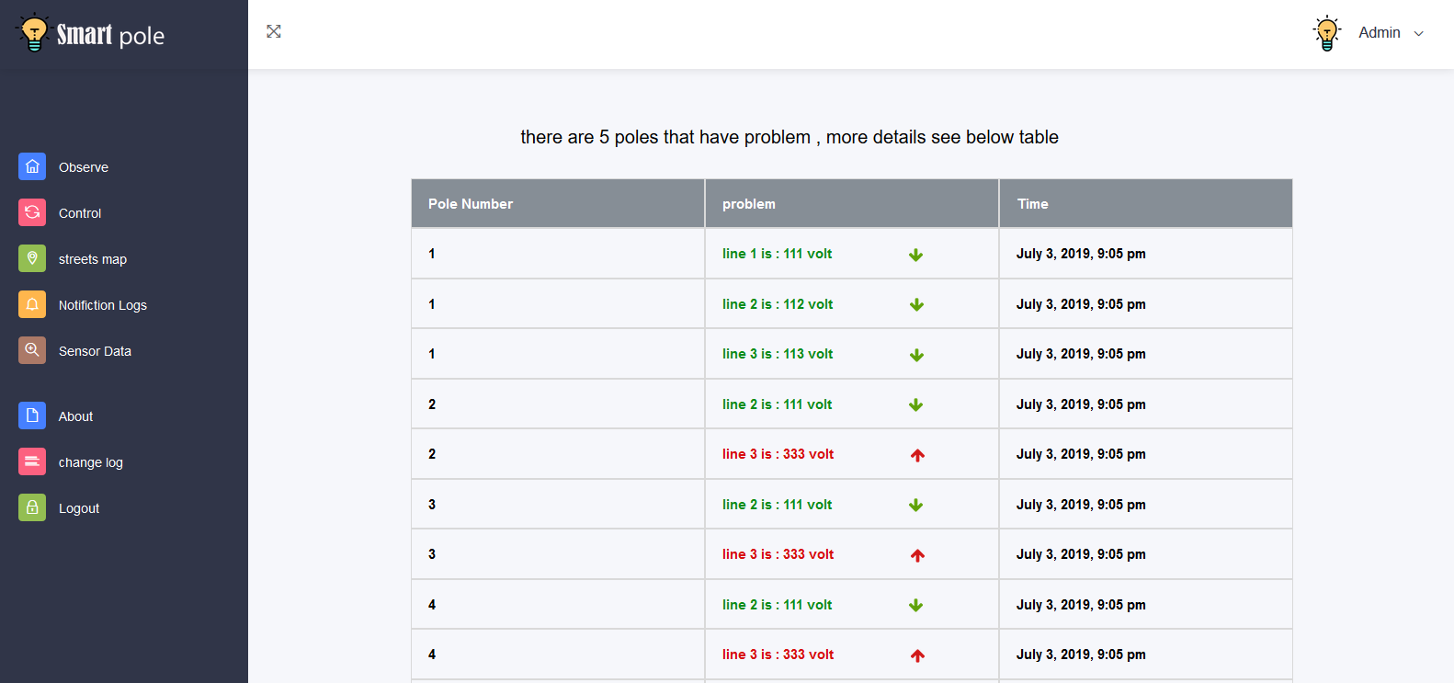
Notification logs
The notification page is consist of Problem that show voltage readings on the line.

Slide 22
Acknowledgment
In every case ………. Good worse….. We must thank the great merciful
Allah for all gifts and blessing that we have been given starting with the
blessings of Islam.
We would like to thank:
Dr. Osama Mohammad Elkomy
My project advisor, for guiding us through each and every step of the
process with knowledge and support. Thank you for your advice, guidance
and assistance.
We would like also thank:
Eng. Mahmoud Mahdi
Who helped in solving the problems and difficulties that we face and he was step by step with us to finish this project.

Slide 23
Thank You

